Slide 1
19. NumPy - Advanced Indexing
Advanced Indexing Operation in NumPy Arrays
https://www.youtube.com/watch?v=2WTDrSkQBng

Slide 2
Indexing
Basic Indexing
Advanced Indexing
1. Integer Indexing
2. Boolean Indexing

Slide 3
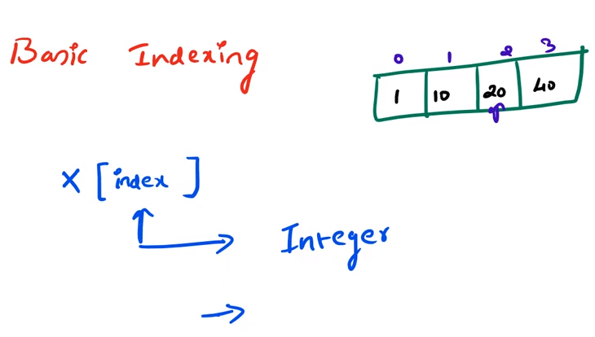
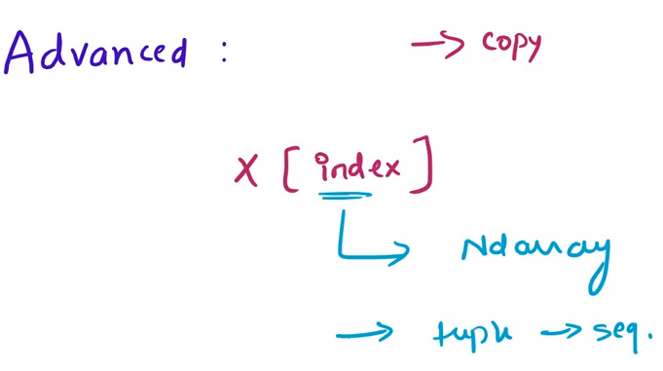
NumPy is a library for the Python programming language,
Large, multi-dimensional arrays and matrices, along with a large collection of high-level mathematical functions to operate on these arrays.
ndarrays can be indexed using the standard Python x[obj] syntax,
where x is the array
obj the selection.

Slide 4
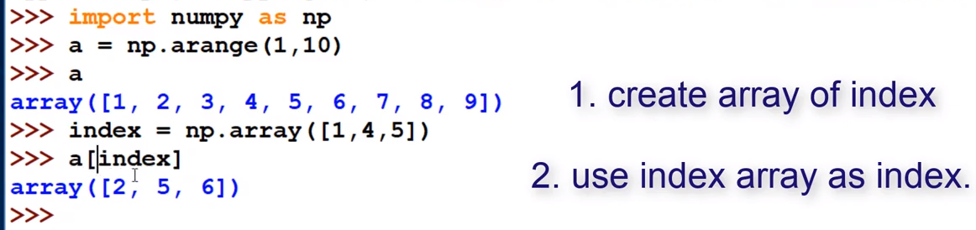
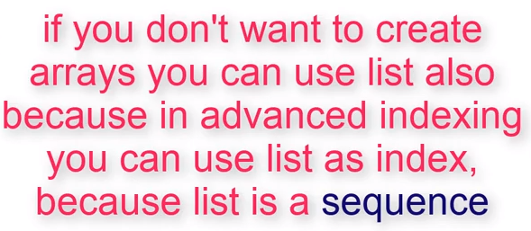
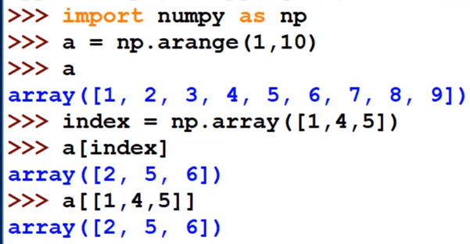
Integer Indexing in One Dimensional Array
1
2

Slide 5
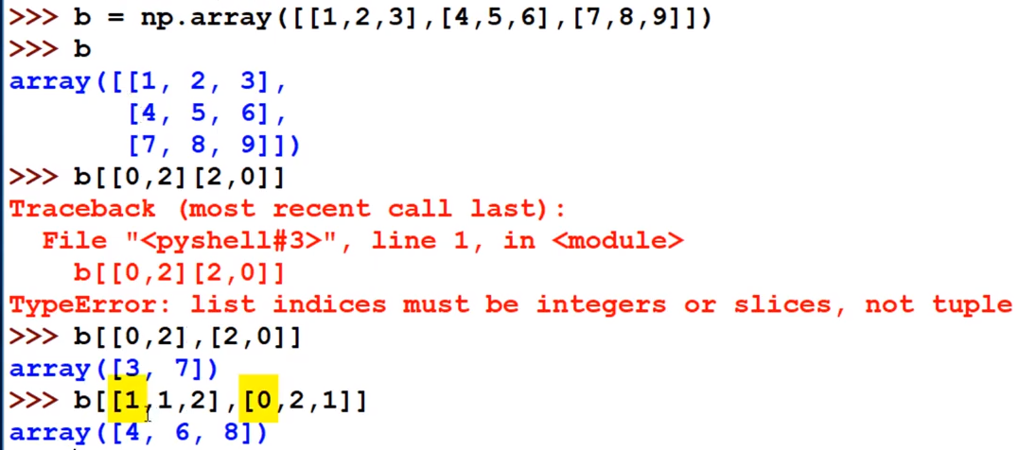
Integer Indexing in Multi Dimensional Array

Slide 6
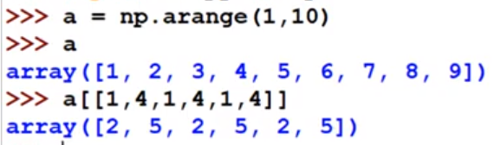
Advanced Indexing
Repeated values

Slide 7
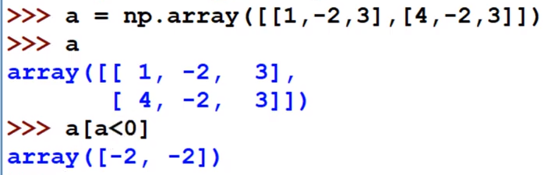
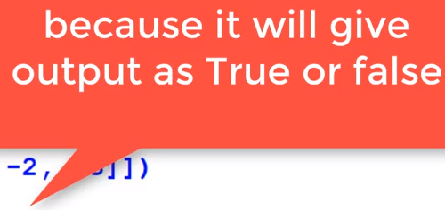
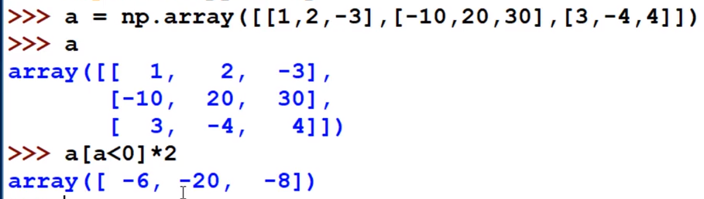
Boolean Indexing

